Slide 1

Customer Shopping Behavior Analysis
Uncovering insights from transactional data to drive strategic business decisions.

Slide 2

Project Overview
This project analyzes customer shopping behavior using transactional data from 3,900 purchases across various product categories.
Goal
Uncover insights into spending patterns, customer segments, product preferences, and subscription behavior.
Data Scope
3,900 purchases, 18 columns, including demographics, purchase details, and shopping behavior.

Slide 3


Dataset Summary
Our dataset comprises 3,900 rows and 18 columns, capturing a comprehensive view of customer interactions.
Rows: 3,900
Columns: 18
Key Features: Customer demographics, purchase details, shopping behavior.
Missing Data: 37 values in the Review Rating column were handled during cleaning.

Slide 4
Exploratory Data Analysis (EDA) in Python
We initiated our analysis with robust data preparation and cleaning using Python.
01
02
03
Data Loading & Exploration
Missing Data Handling
Column Standardization
Imputed missing 'Review Rating' values using median per product category.
Renamed columns to snake_case for improved readability.
Imported dataset with pandas, checked structure and summary statistics.
04
05
Feature Engineering
Database Integration
Created 'age_group' and 'purchase_frequency_days' columns.
Loaded cleaned data into PostgreSQL for SQL analysis.

Slide 5

Key Business Questions & SQL Insights
Structured analysis in PostgreSQL answered critical business questions, revealing spending patterns and preferences.
1
Revenue by Gender
Male customers generated $157,890, Female customers $75,191.
2
High-Spending Discount Users
Identified 839 customers who used discounts but spent above average.
3
Top 5 Products by Rating
Gloves (3.86), Sandals (3.84), Boots (3.82), Hat (3.80), Skirt (3.78).
4
Shipping Type Comparison
Express shipping users had a higher average spend ($60.48) than Standard ($58.46).

Slide 6

Subscription & Discount Dynamics
Understanding how subscriptions and discounts influence customer behavior and product appeal.
Subscribers vs. Non-Subscribers
Subscribers (1053) had an average spend of $59.49, contributing $62,645 in revenue.
Discount-Dependent Products
Hat (50%), Sneakers (49.66%), Coat (49.07%), Sweater (48.17%), Pants (47.37%) had highest discount rates.

Slide 7



Customer Segmentation & Loyalty
Classifying customers into distinct segments based on their purchase history.
New
1
83 Customers
Returning
2
701 Customers
Loyal
3
3116 Customers
Customers with more than 5 purchases are more likely to subscribe (958 Yes vs 2518 No).

Slide 8
Top Products by Category
Identifying the most purchased items within each product category.
Accessories
Jewelry
171
Accessories
Sunglasses
161
Clothing
Blouse
171
Clothing
Pants
171
Footwear
Sandals
160
Footwear
Shoes
150
Outerwear
Jacket
163
Outerwear
Coat
161

Slide 9
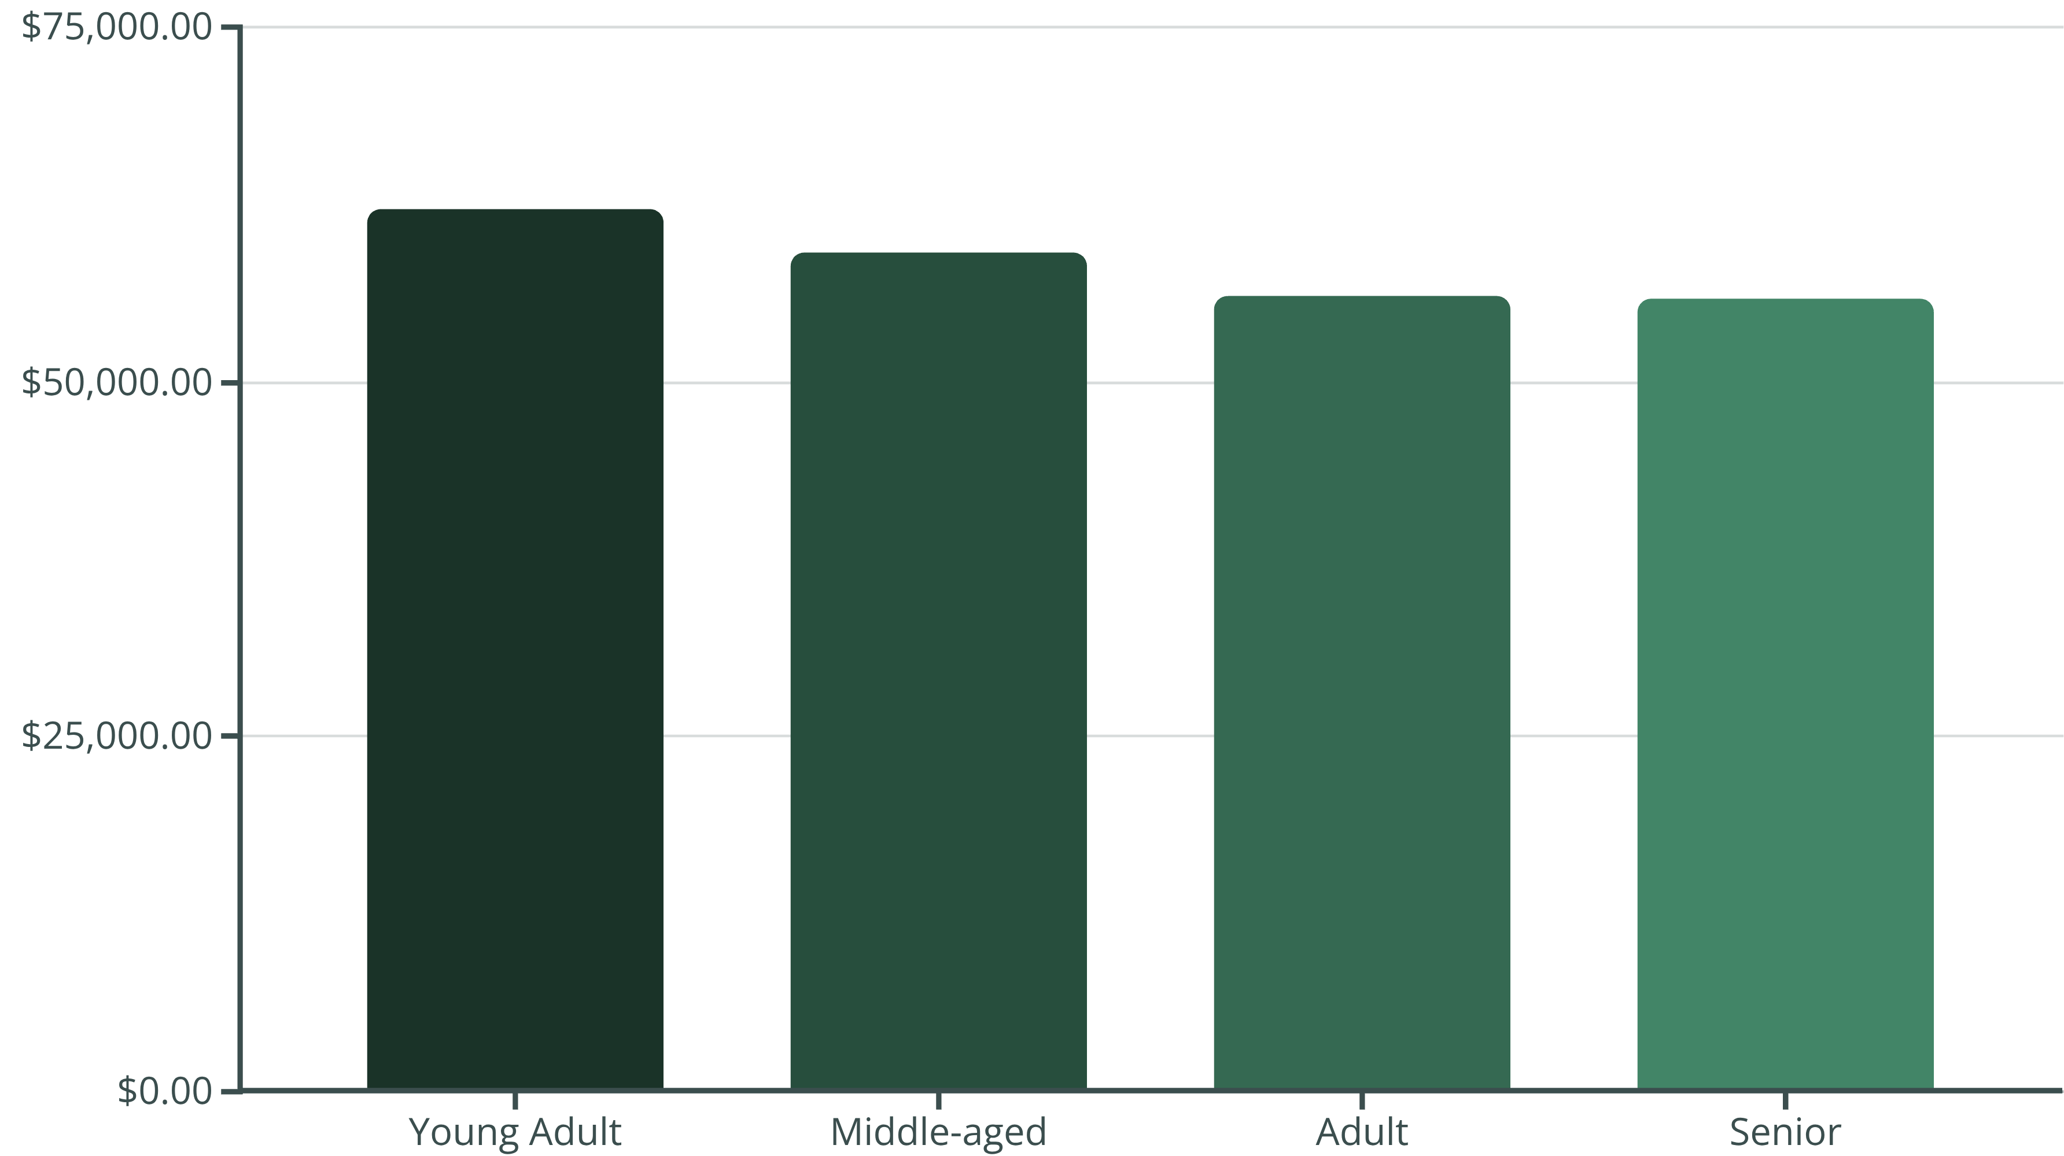
Revenue Contribution by Age Group
Analyzing which age demographics contribute most to overall revenue.
Young Adults represent the highest revenue-generating segment.

Slide 10

Business Recommendations
Leveraging insights to optimize strategies and enhance customer engagement.
Boost Subscriptions
Promote exclusive benefits to increase subscriber base.
Customer Loyalty Programs
Reward repeat buyers to foster loyalty and move them into the "Loyal" segment.
Review Discount Policy
Strategically balance sales boosts with margin control.
Product Positioning
Highlight top-rated and best-selling products in marketing campaigns.
Targeted Marketing
Focus efforts on high-revenue age groups and express-shipping users.

